Slide 1


Creating a static website for the kl university
Form Team:4
INDUPALLI SHARON MERCY (TEAM LEAD)

Slide 2
TEAM : 4
Team members :
1. INDUPALLI SHARON MERCY (TEAM LEAD)
2.AVULA SAI NAVEEN
3. MANGALAGIRI MAHIMA
4. SETTY SAHITHI
5. YARROJU LAKSHMI KOMALI
Team members :
6.YARRAMSETTI BHAVANI
7.RAVELLA YESWANTH
8.KALLAM HYMAVATHI
9.SHAIK ARIF SOHIL
10. KATRAGADDA SANDEEP

Slide 3
Creating a static website for the kl university
Creating a static website for a kl university on AWS involves several steps, including hosting the website, storing the content, and configuring the domain.
Here's a step-by-step guide to help you set up a static website for your kl university on AWS

Slide 4
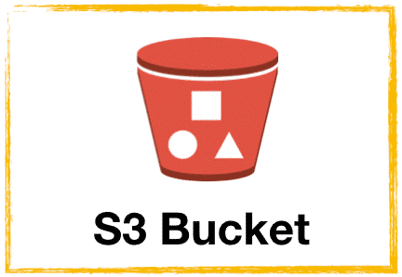
S3 Bucket in aws
An S3 (Simple Storage Service) bucket is a widely-used object storage service provided by Amazon Web Services (AWS). It allows you to store and retrieve any amount of data from anywhere on the web. S3 is designed to be highly scalable, durable, and secure, making it a versatile solution for various applications.

Slide 5
S3 Bucket in aws
Here are some of the common applications of S3 buckets in AWS:
1:Static Website Hosting
2:Big Data Analytics
3:Backup and Restoration of EC2 Instances
4:IoT Data Storage
5:Machine Learning Data Storage

Slide 6
Creating a static website for the kl university
Step:1
Go to the AWS Management Console.Search for "S3" and open the S3 service.Click "Create bucket" and provide a unique name for your bucket (e.g., "your-kl university-static-website").Select the region closest to your cafe's primary audience for faster access.Uncheck the "Block all public access" option.Check the "I acknowledge that the current settings might result in this bucket and the objects within becoming public" box.Click "Create bucket."Upload Website Content:

Slide 7
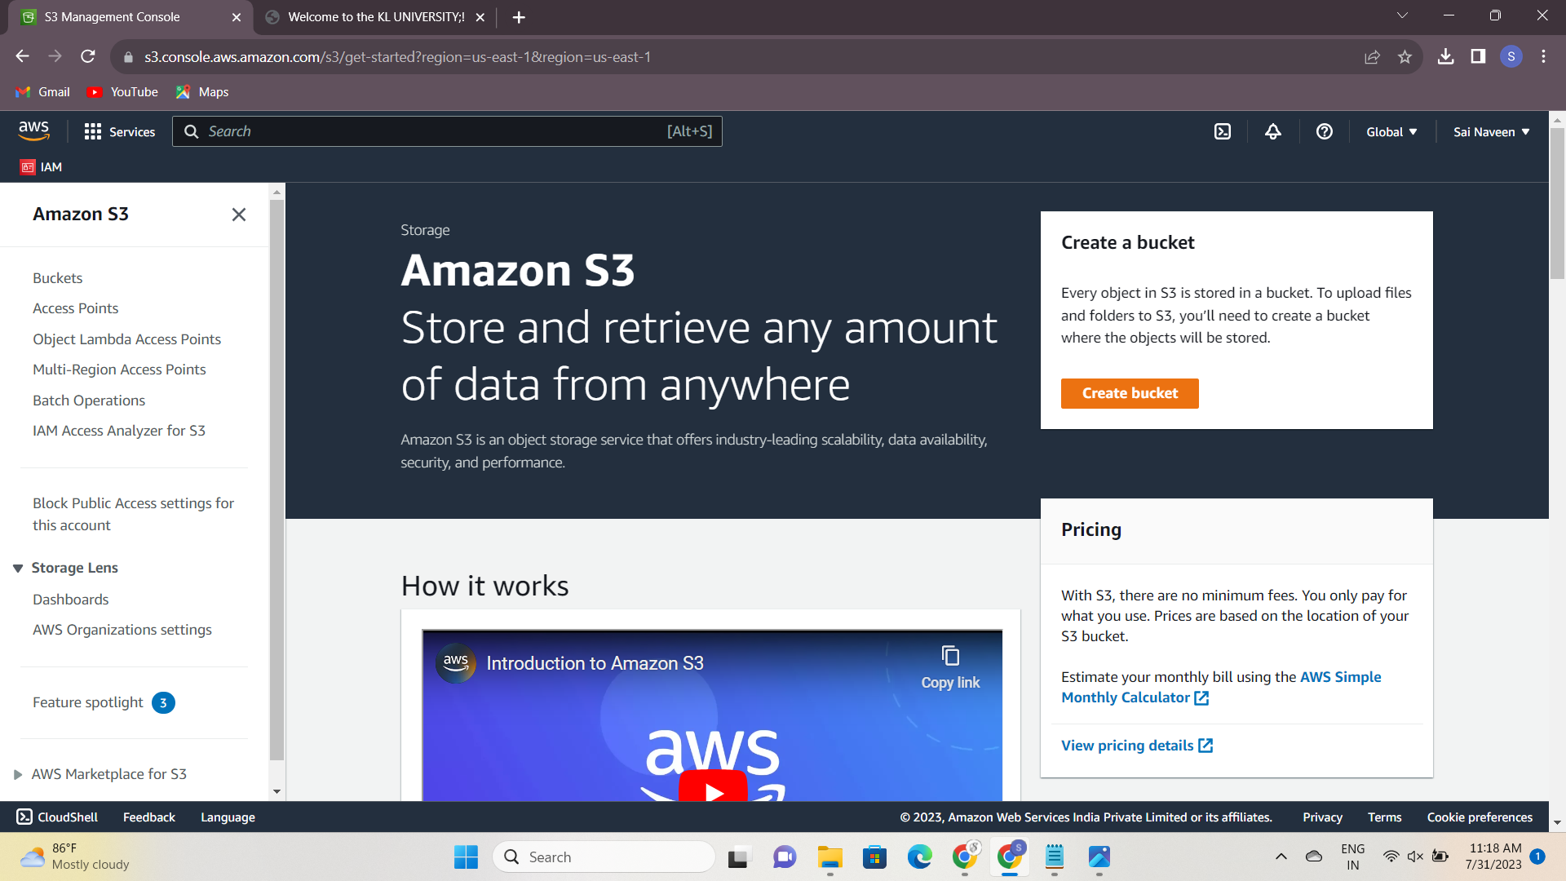

Slide 8
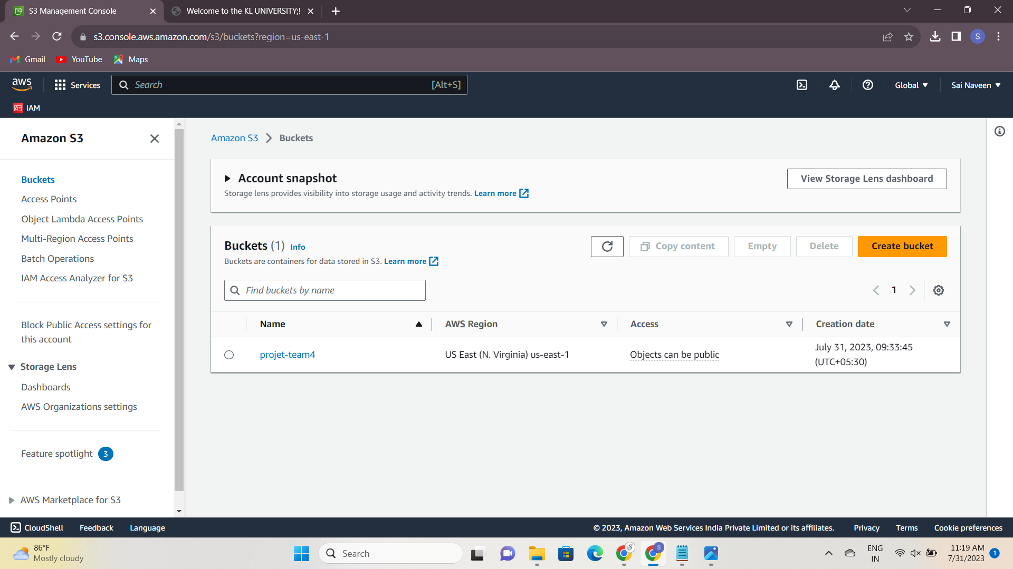

Slide 9
Creating a static website for the kl university
Step:2
Once your S3 bucket is created, go to the bucket you just made. Click "Upload" and select all the files and folders of your website (HTML, CSS, JavaScript, images, etc.).Make sure to set the proper permissions to allow public access to the uploaded files. Select the uploaded files, click "Actions," and then "Make public." Enable Static Website Hosting

Slide 10
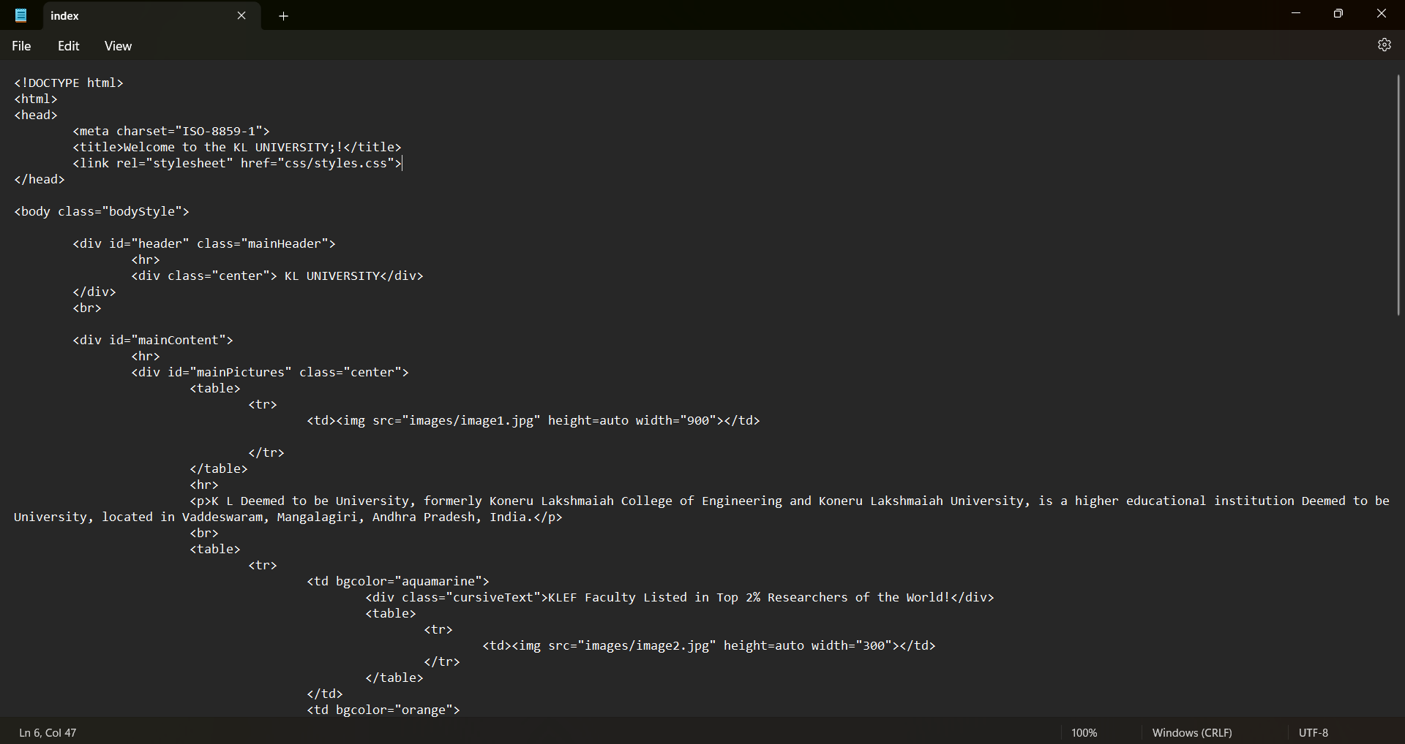

Slide 11
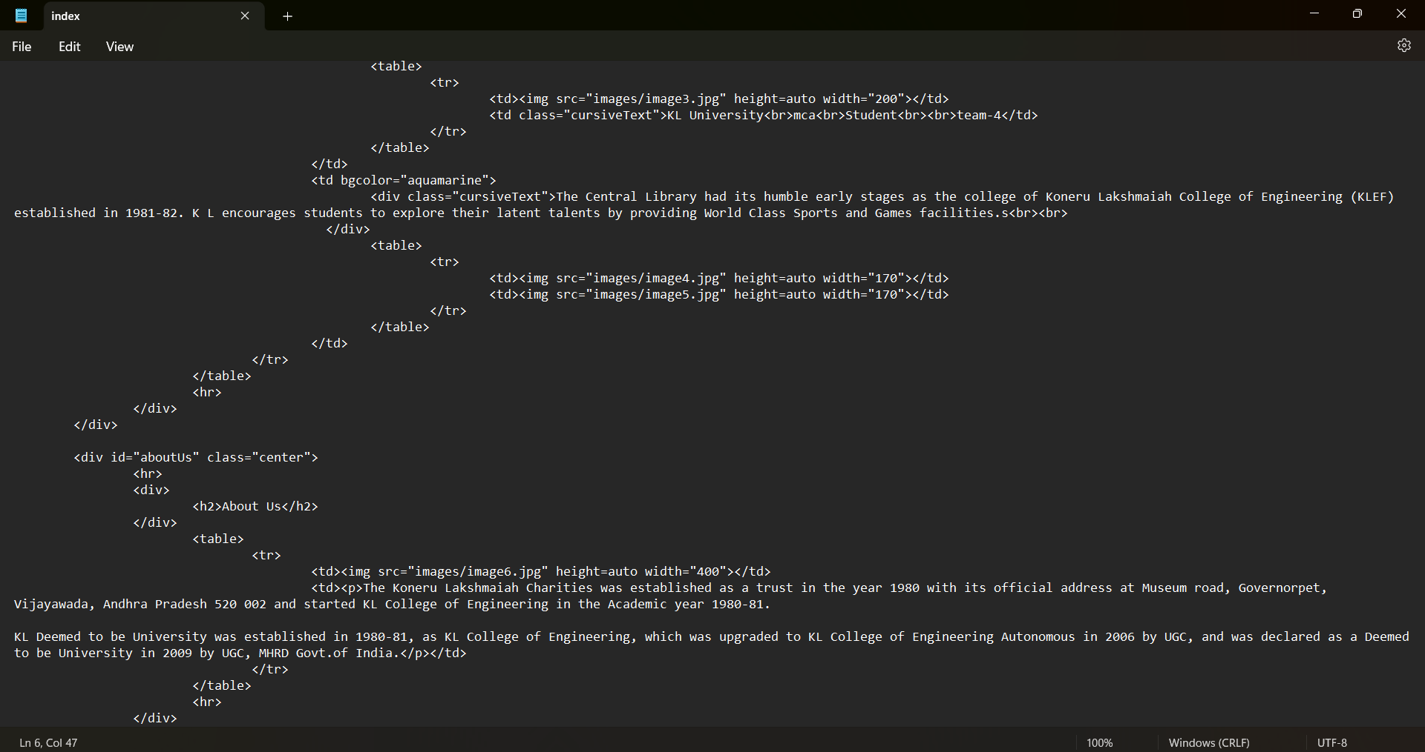

Slide 12
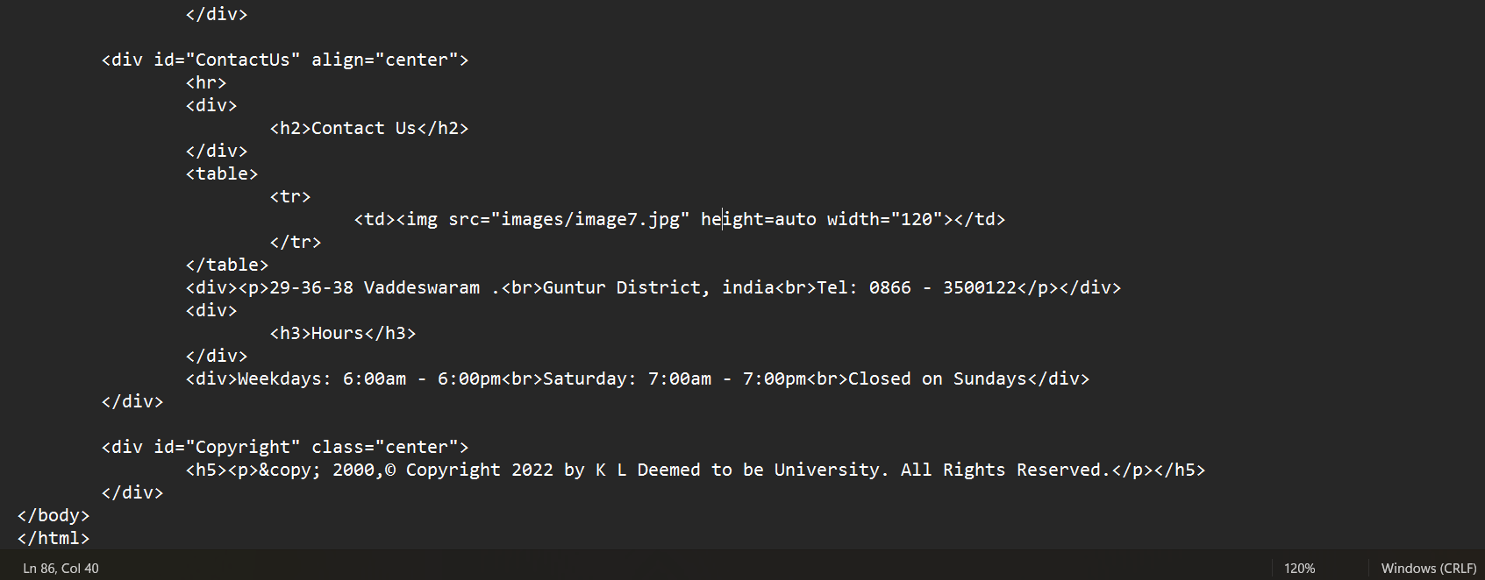

Slide 13
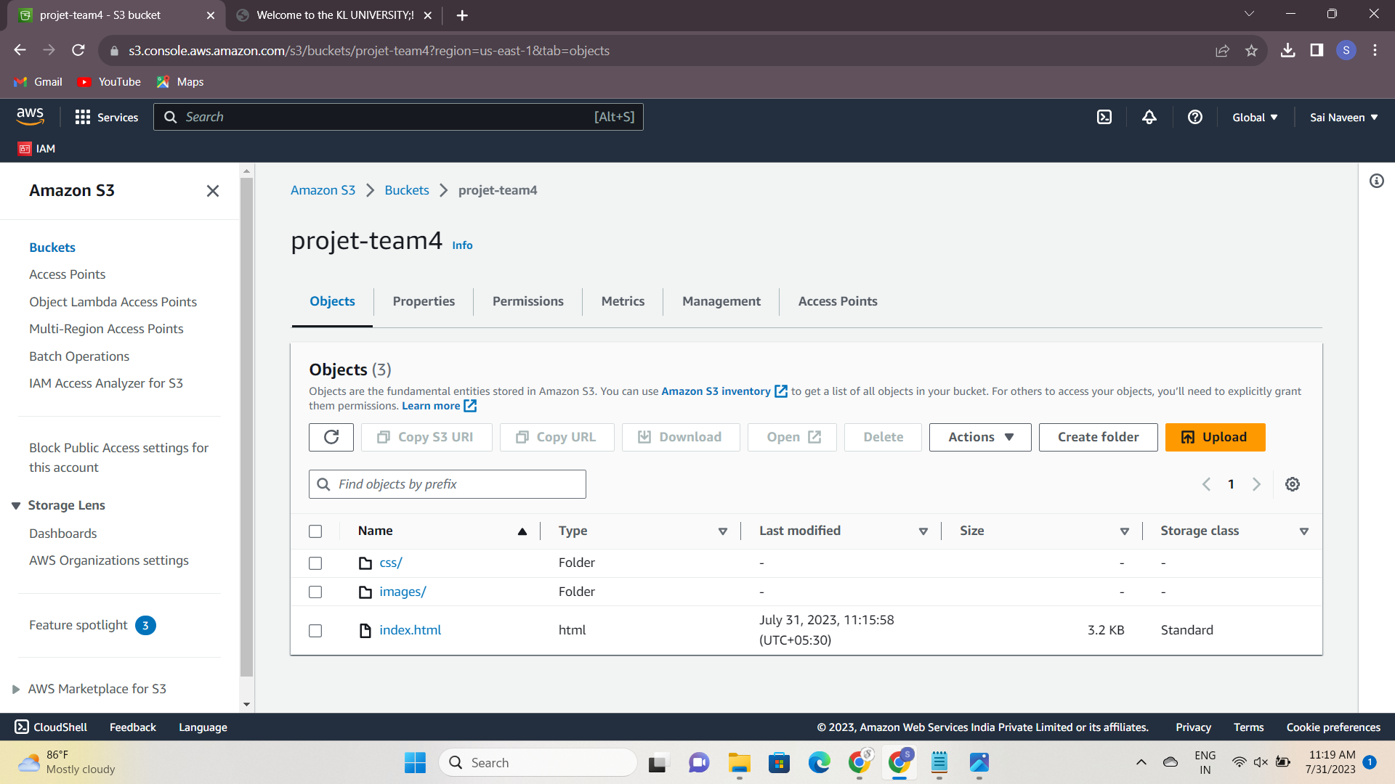

Slide 14
Creating a static website for the kl university
Step:3
Go to the bucket's "Permissions" tab and click "Bucket Policy." Paste the bucket policy and click "Save." Testing the Website: At this point, your static website should be live and accessible through the S3 bucket endpoint URL. To test, open a web browser and enter the endpoint URL .

Slide 15
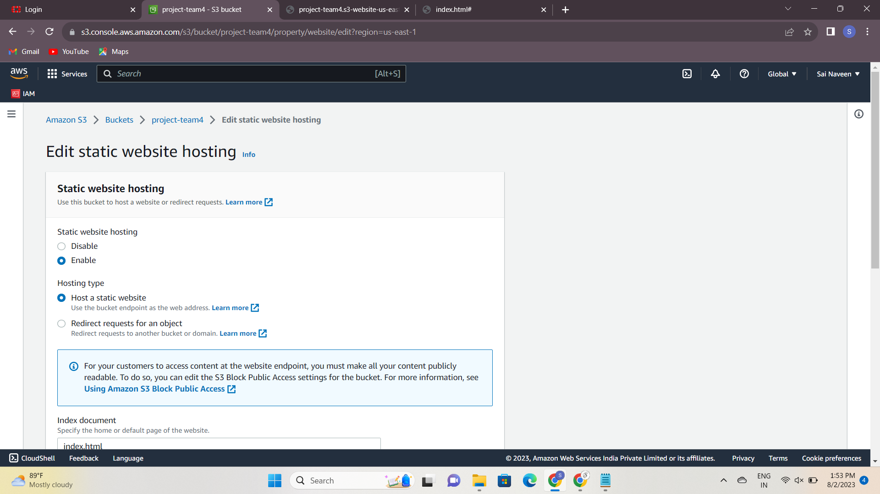

Slide 16
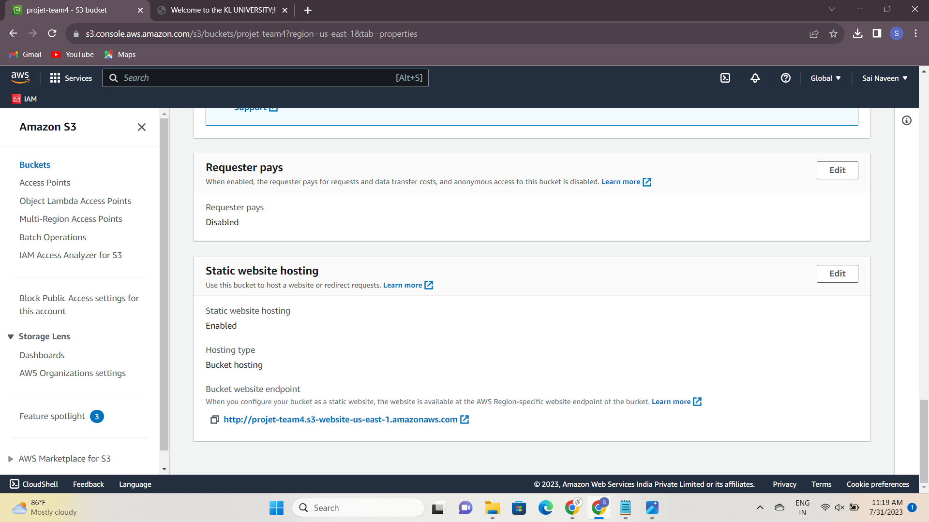

Slide 17
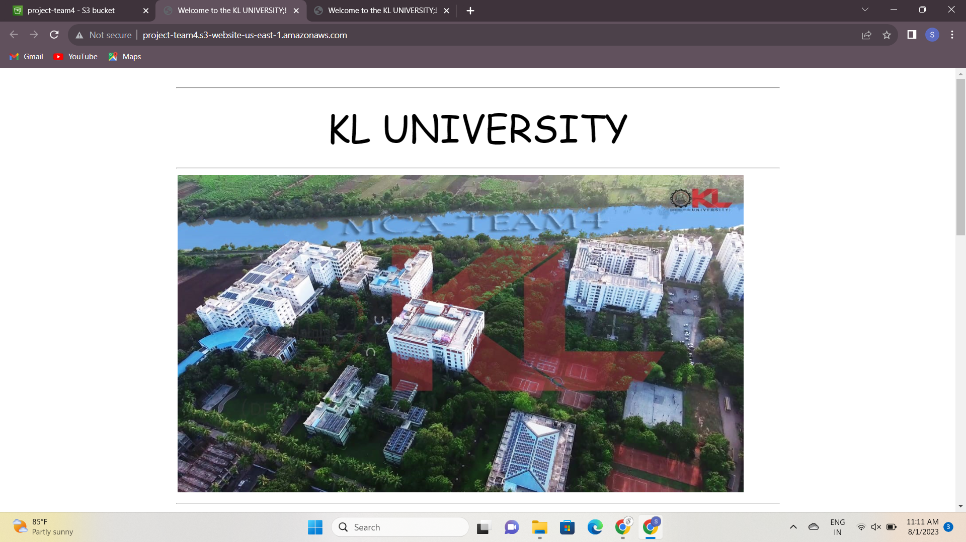

Slide 18
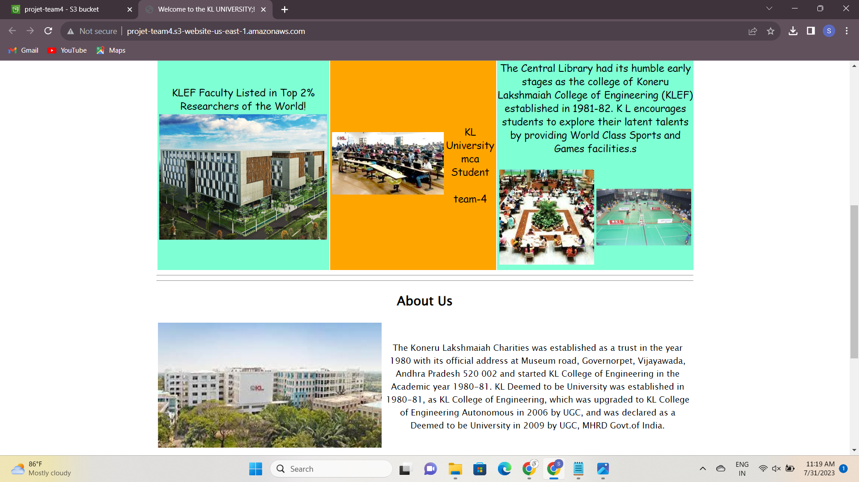

Slide 19
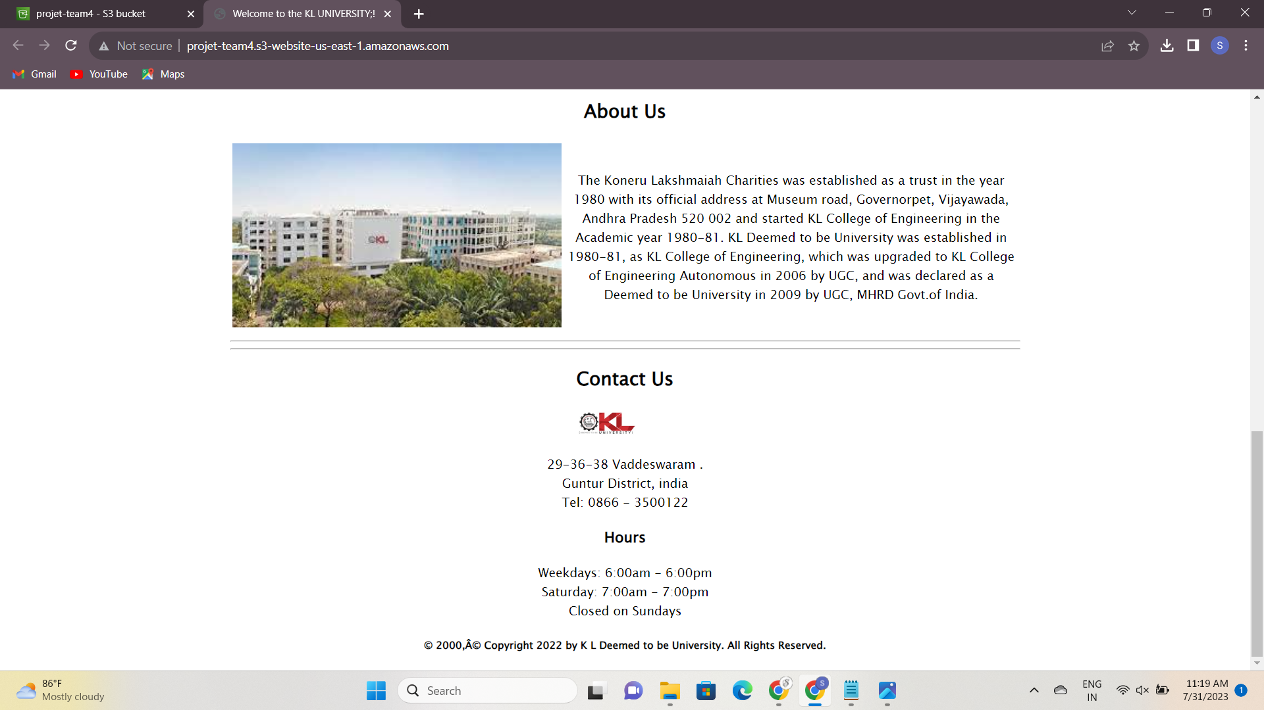

Slide 20


